Slide 1
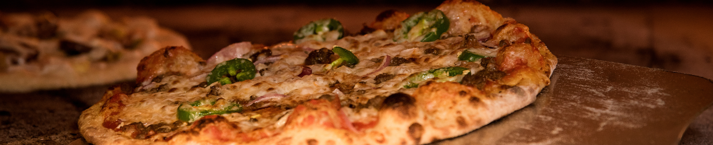
PIZZA SALES ANALYSIS
USING SQL AND POWERBI

Slide 2
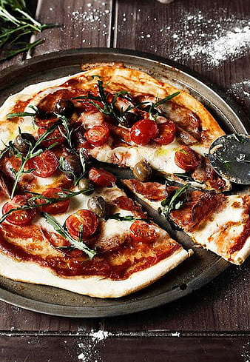
CONTENT
Overview
Dataset and methodology
Dataset Details
Project Details
PowerBI Dashboard
Insights
Recommendations
Conclusion

Slide 3
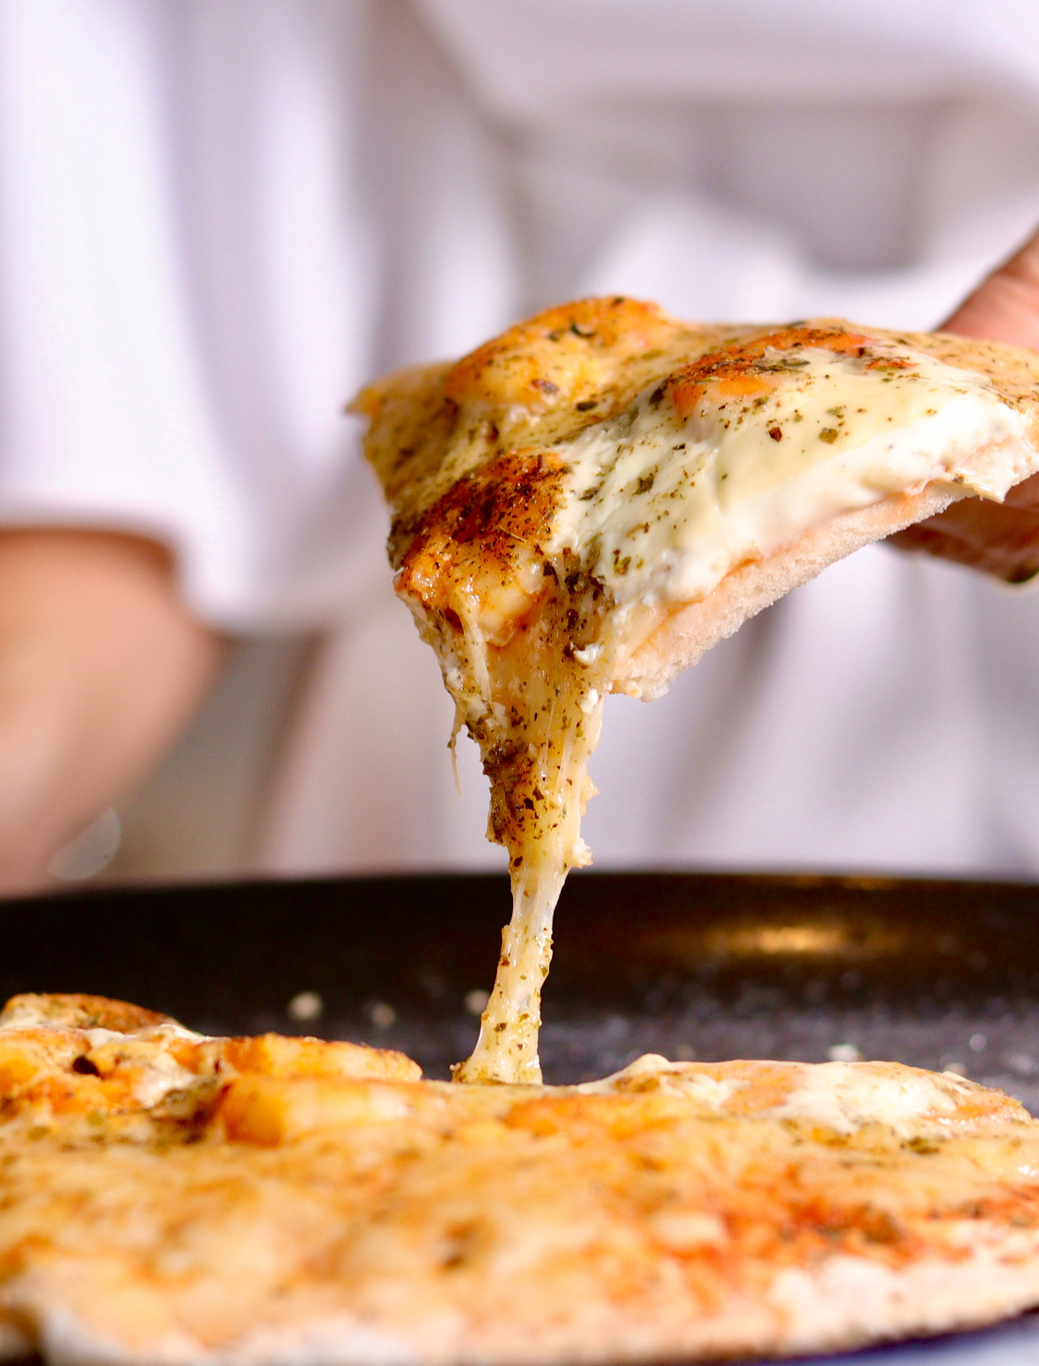
OVERVIEW
The project on pizza sales analysis aims to utilize SQL and PowerBI to analyze and visualize a comprehensive dataset of pizza sales. By utilizing SQL queries, the project aims to uncover meaningful insights into popular pizza types, sales trends and overall performance where as PowerBI transforms this data into interactive dashboards so user can easily enable to visualize trends, track performance by sales channel and assess marketing effectiveness.

Slide 4
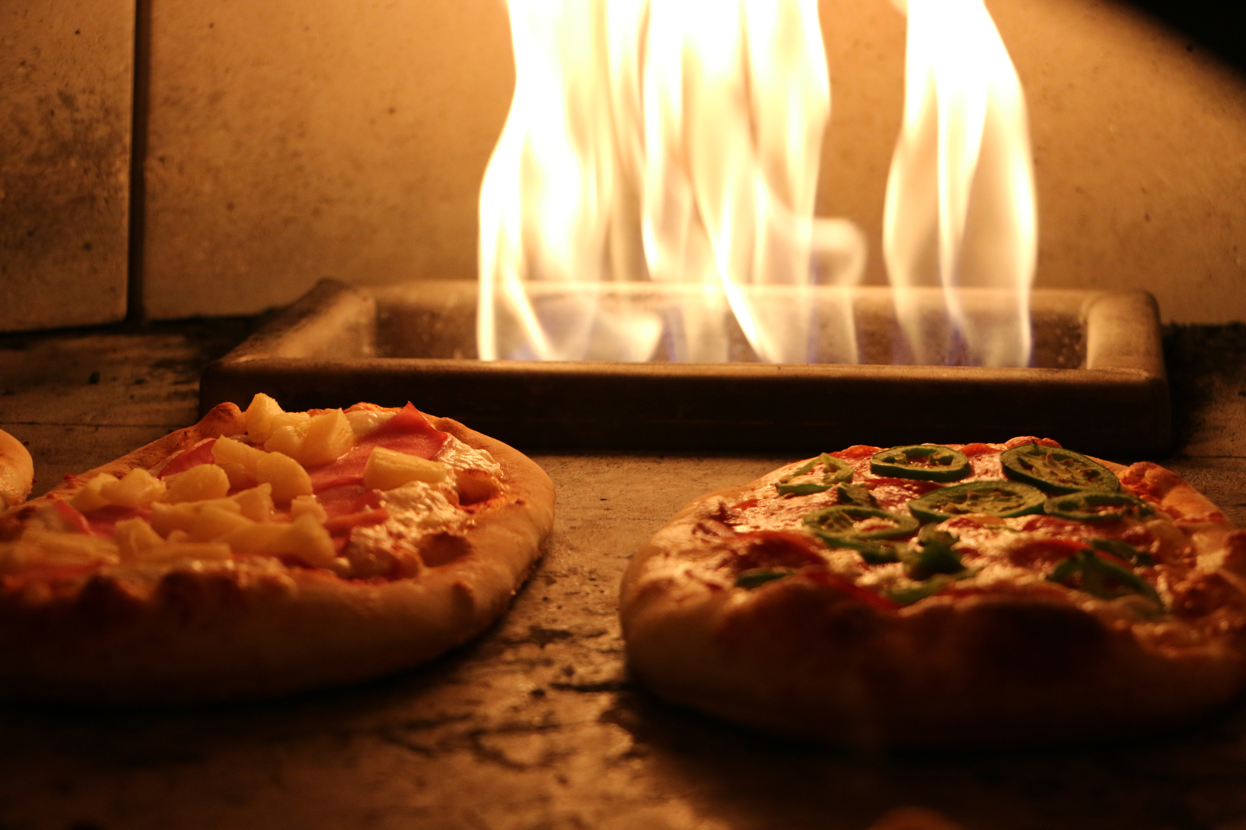
Data Source & Methodology
The dataset used in this project consists of pizza sales data obtained from Kaggle. It includes information such as order id, order date, quantity, pizza price, pizza size and so on.
Data Source
The analysis is performed using SQL queries to extract, transform and analyze the data, with various SQL functions and techniques used to derive key metrics and perform statistical analysis where as PowerBI created interactive dashboards to make it visible.
Methodology

Slide 5
Dataset details:
order_details
orders
order_details_id: Unique identifier for each pizza placed within each order
order_id: Unique identifier for each order placed by a table
pizza_id: Unique key identifier that ties the pizza ordered to its details, like size and price
quantity: Quantity ordered for each pizza of the same type and size
order_id: Unique identifier for each order placed by a table
date: Date the order was placed
time: Time the order was placed
pizzas
pizza_types
pizza_id: Unique key identifier that ties the pizza ordered to its details, like size and price
pizza_type_id: Unique identifier for the pizza type
size: Size of the pizza (Small, Medium, Large, X Large, or XX Large)
price: Price of the pizza
pizza_type_id: Unique identifier for the pizza type
name: Name of the pizza as shown in the menu
category: Category of the pizza (eg. vegetarian, meat etc.)
ingredients: ingredients used in the pizza

Slide 6
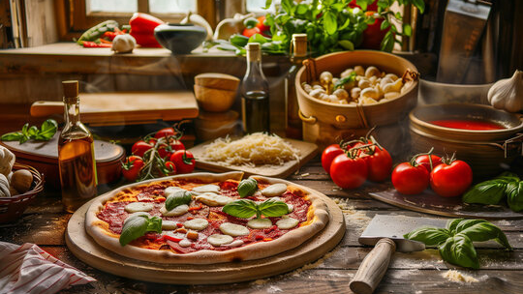

PROJECT DETAILS

Slide 7
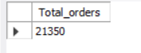

Total number of order placed
select count(distinct order_id) as Total_orders
from order_details;

Slide 8
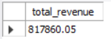
Total Revenue generated from pizza sales
select cast(sum(order_details.quantity*pizzas.price) as decimal(10,2)) as total_revenue
from order_details
join pizzas on order_details.pizza_id = pizzas.pizza_id;

Slide 9
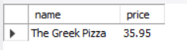
The highest priced pizza
select pizza_types.name, pizzas.price as price
from pizzas
join pizza_types on pizzas.pizza_type_id = pizza_types.pizza_type_id
order by pizzas.price desc
limit 1;

Slide 10
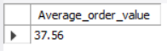
Average order value
select cast((sum(pizzas.price)/count(distinct order_details.order_id)) as decimal(10,2)) as Average_order_value
from order_details
join pizzas on order_details.pizza_id = pizzas.pizza_id;

Slide 11
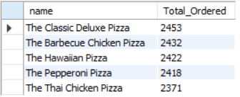
Top 5 most ordered pizza types along their quantities
select pizza_types.name, sum(order_details.quantity) as Total_Ordered
from order_details
join pizzas on order_details.pizza_id = pizzas.pizza_id
join pizza_types on pizza_types.pizza_type_id = pizzas.pizza_type_id
group by pizza_types.name
order by sum(order_details.quantity) desc
limit 5;

Slide 12
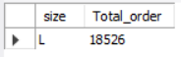
Most common pizza size ordered
select pizzas.size as size , count(order_details.order_id) as Total_order
from pizzas
join order_details on pizzas.pizza_id = order_details.pizza_id
group by pizzas.size
order by count(order_details.order_id) desc
limit 1;

Slide 13
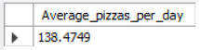
The average no. of pizzas ordered per day
select avg(Daily_pizzas) as Average_pizzas_per_day
from (select orders.date, sum(order_details.quantity) as Daily_pizzas
from orders
join order_details on orders.order_id = order_details.order_id
group by orders.date)
as Daily_order;

Slide 14
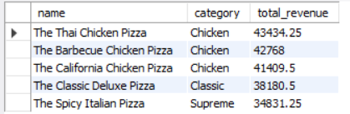
Top 5 most order pizza type based on revenue for each pizza category
select pizza_types.name, pizza_types.category, sum(order_details.quantity*pizzas.price) as total_revenue
from order_details
join pizzas on order_details.pizza_id = pizzas.pizza_id
join pizza_types on pizzas.pizza_type_id = pizza_types.pizza_type_id
group by pizza_types.name,pizza_types.category
order by total_revenue desc
limit 5;

Slide 15
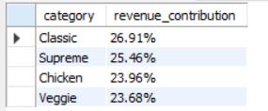
The percentage contribution of each pizza type of revenue
with Total_Revenue as (
select sum(order_details.quantity * pizzas.price) as total_revenue
from order_details
join pizzas on order_details.pizza_id = pizzas.pizza_id
),
Category_Revenue as (
select pizza_types.category,
sum(order_details.quantity * pizzas.price) as category_revenue
from order_details
join pizzas on order_details.pizza_id = pizzas.pizza_id
join pizza_types on pizzas.pizza_type_id = pizza_types.pizza_type_id
group by pizza_types.category
)
select category,
concat(cast((category_revenue / total_revenue * 100) as decimal(10,2)), '%') as revenue_contribution
from Category_Revenue, Total_Revenue
order by revenue_contribution desc;

Slide 16

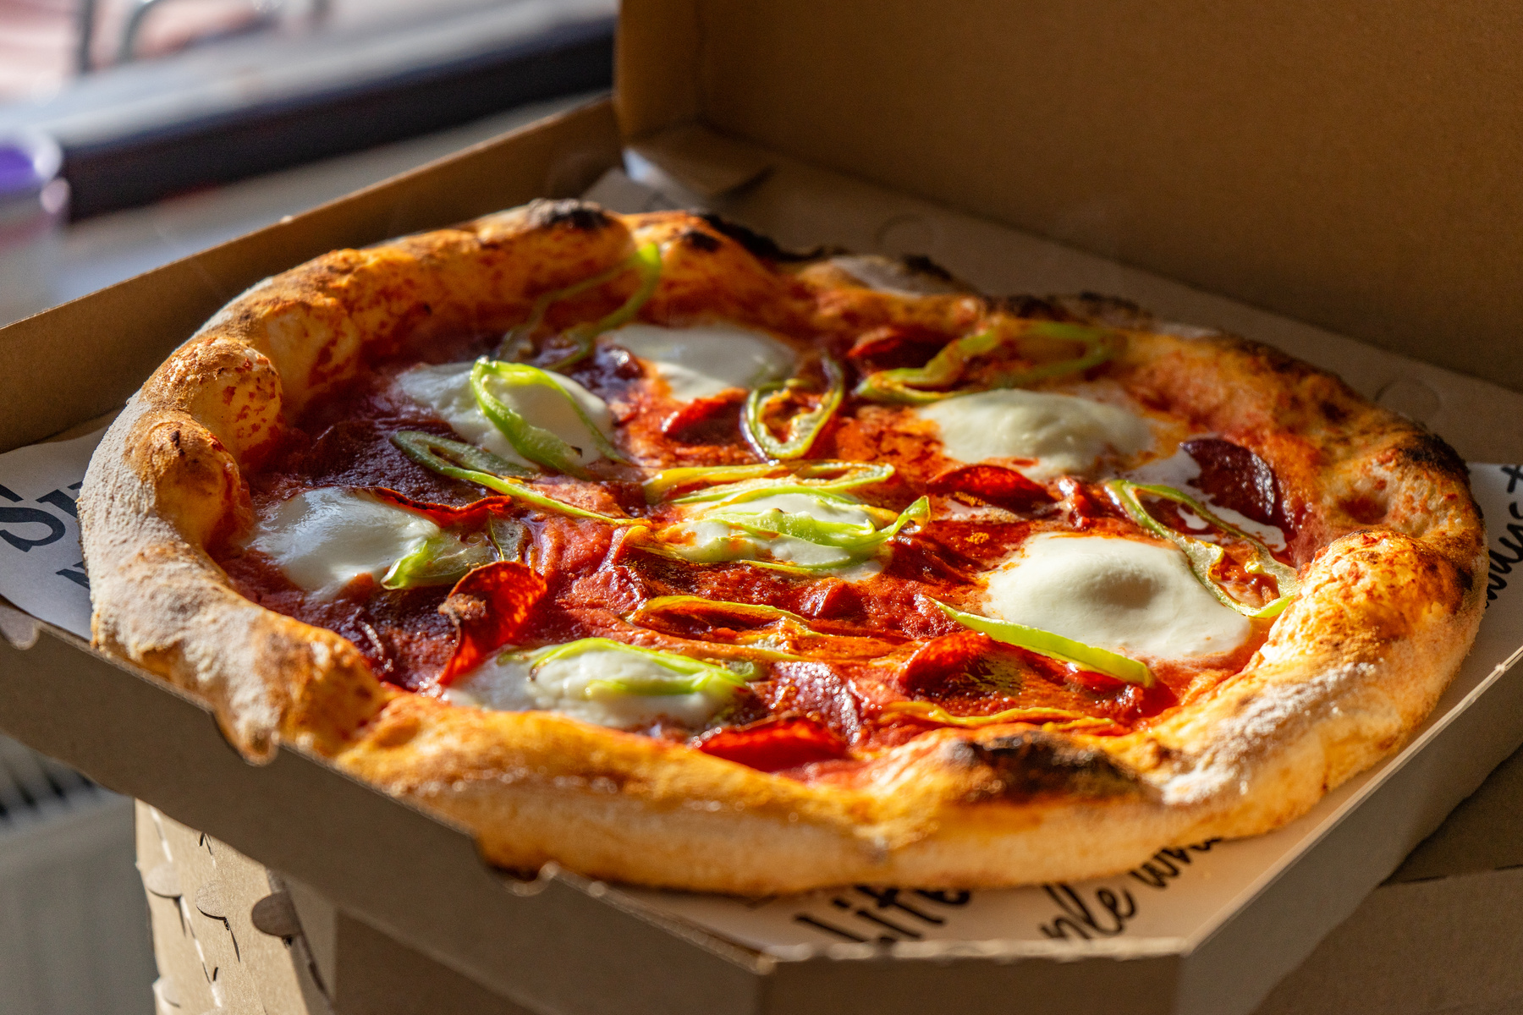
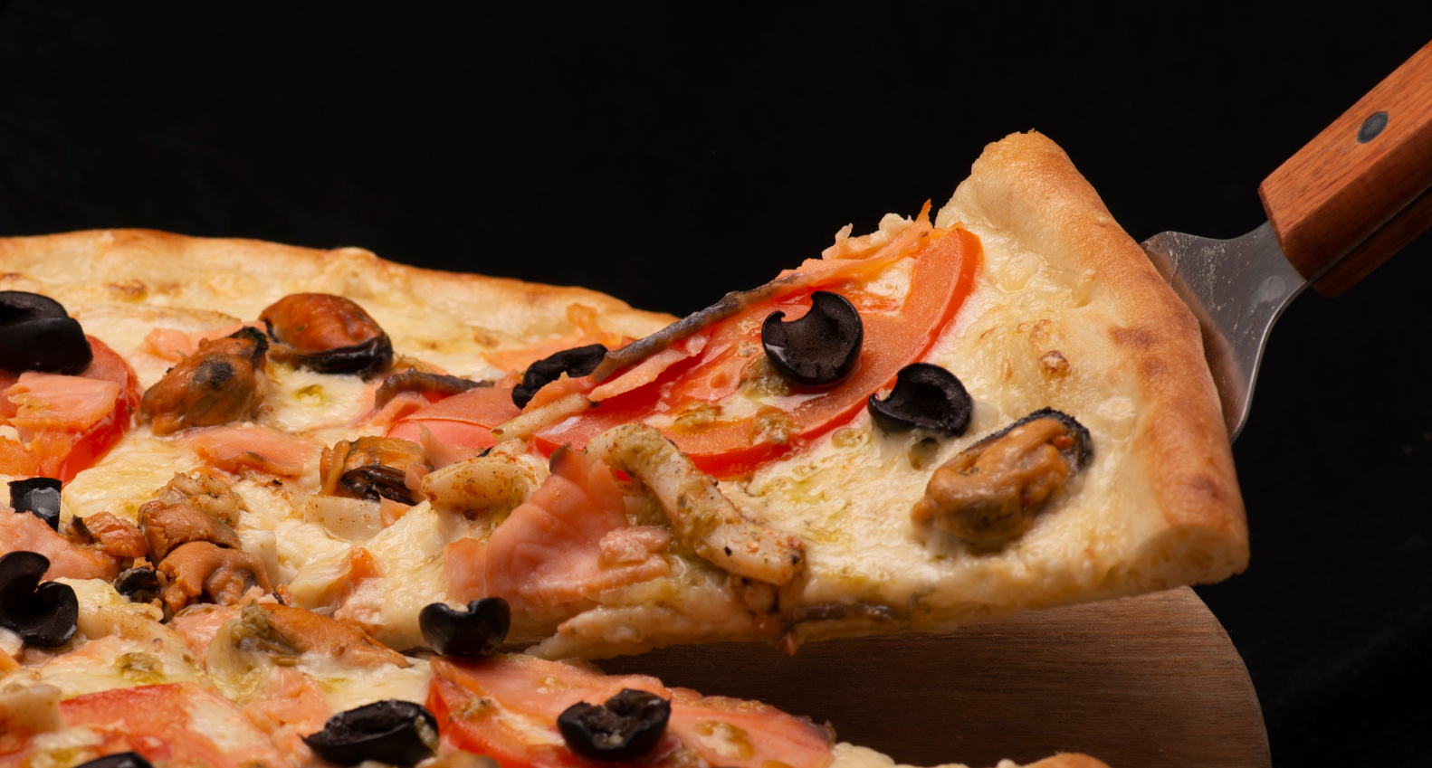
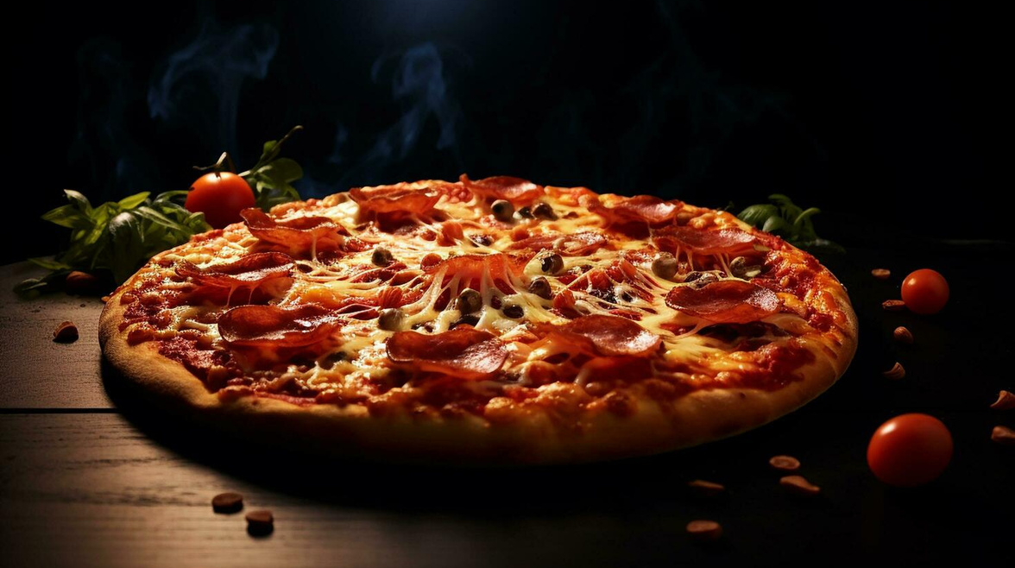
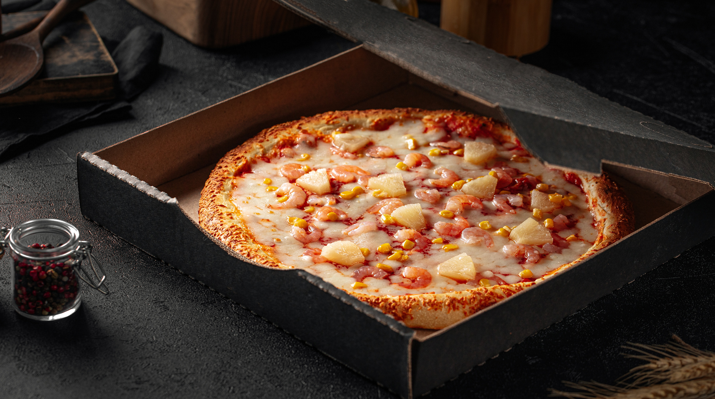
POWERBI DASHBOARD

Slide 17
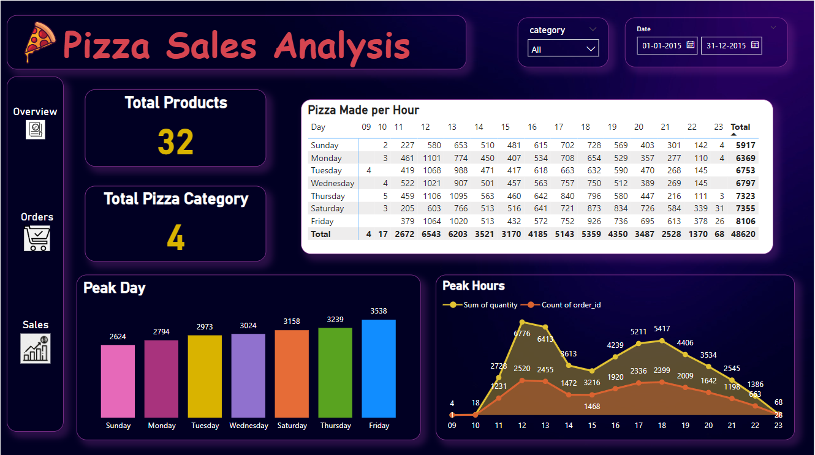

Slide 18
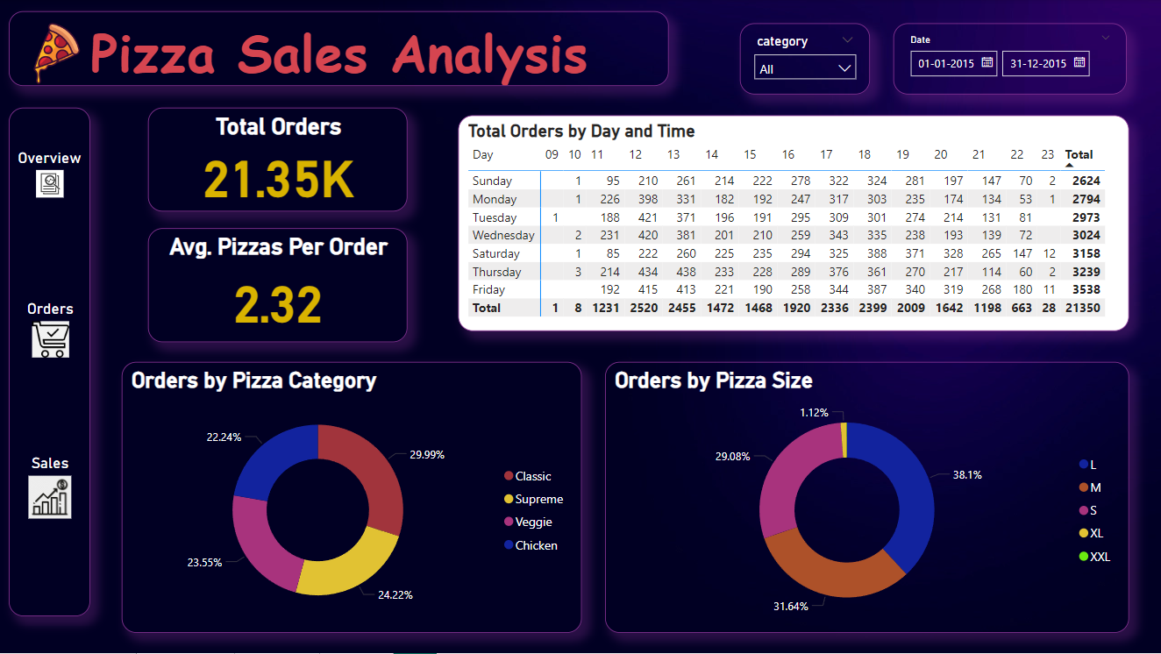

Slide 19
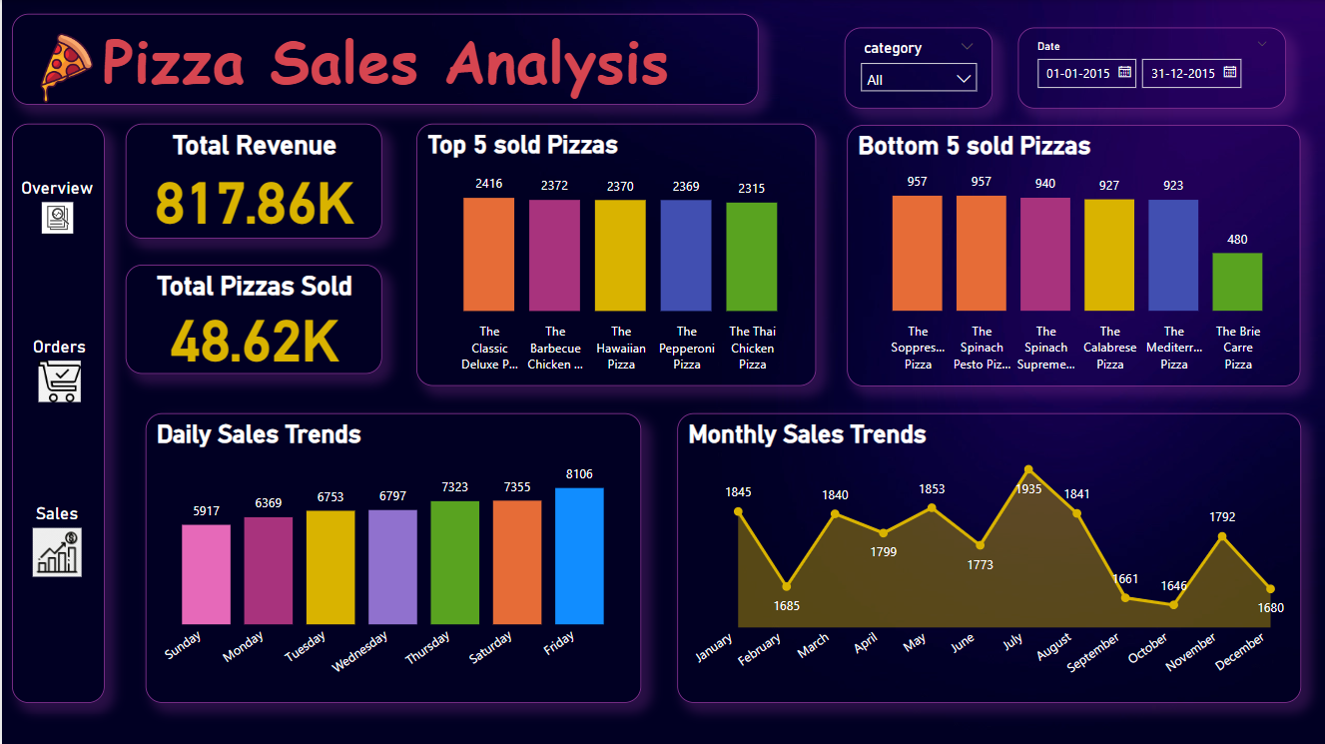

Slide 20
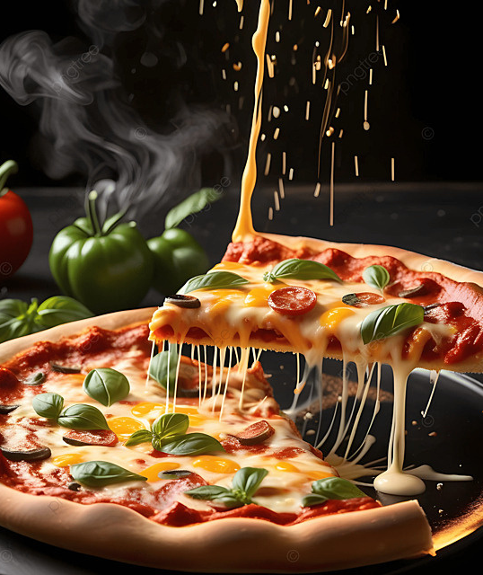
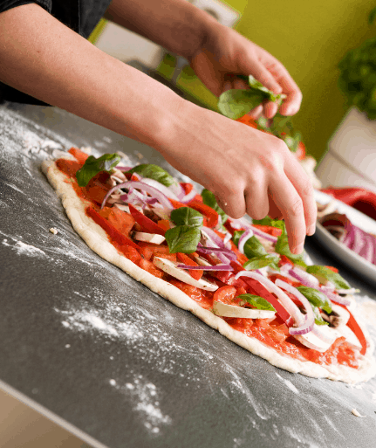
INSIGHTS:
The total number of orders received was 21,350. The Classic Deluxe Pizza was the best selling pizza, with 2416 orders and The Brie Carre Pizza was the lowest selling pizza with 480 orders, generating the lowest number of orders.
In July, we had the highest order with a count of 1935, while the lowest order count is 1646 in October.
We have peak hours between 12:00PM with 2520 orders and 1:00PM with 2455 orders.
We reached the peak order of 3538 on Fridays and 3239 on Thursdays, marking that Fridays are the most busy days.
The busiest hours for pizza orders are between 12:00 PM to 1:00 PM and 5:00 PM to 6:00 PM, indicating high demand during lunch time and in the evening.

Slide 21
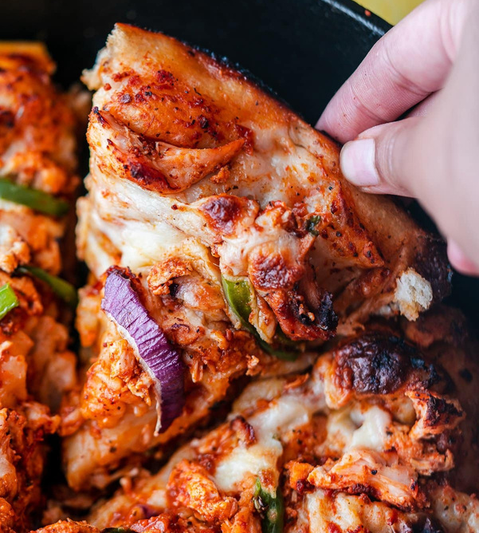
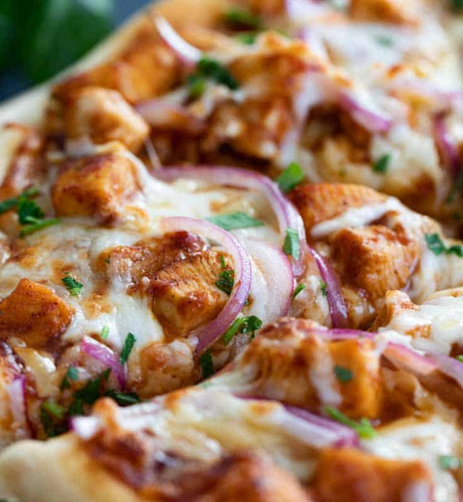
INSIGHTS:
The total revenue was 817.86K.
Large sized pizzas are the most popular preference among clients, representing approximately 38% of total sales, followed by medium sized pizzas at 32% and small sized pizzas at 29%.
The total sales by all four Pizza Categories is almost same, with classic category leading, followed closely by supreme category.
Among pizzas, Thai Chicken Pizza generates the best sales, while Classic Deluxe Pizza is the most frequently ordered by customers. Brie Carre Pizza is the least favored option.

Slide 22
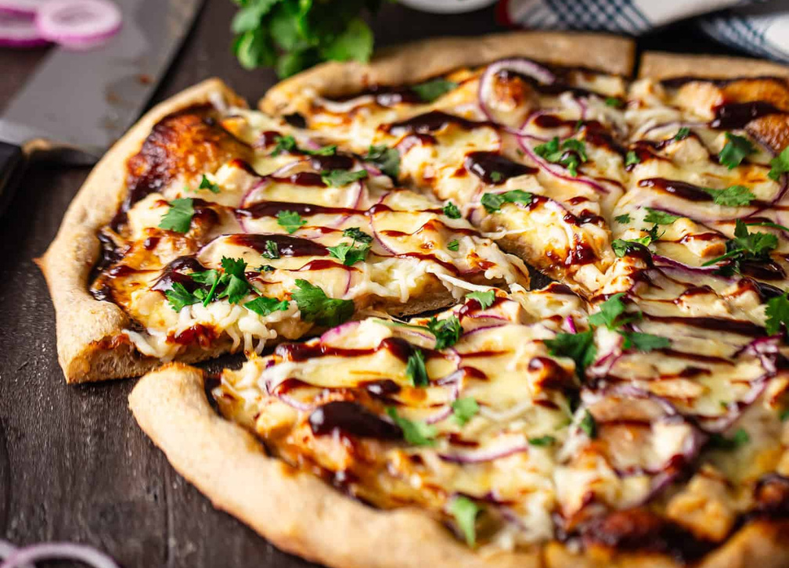
RECOMMENDATIONS:
The Brie Carre Pizza is the lowest selling pizza. We should conduct a survey to understand the customers point of view about this pizza. This will help to identify and resolve the issues behind The Brie Carre Pizza being the lowest selling pizza whether through rebranding, changing recipes or any other strategies.
We should improve our delivery channels to increase the delivery rate during peak days and hours. We should also implement online ordering channel for the customers, who prefer to be in their comfort zone to place order seamlessly and have their pizza delivered.
It is recommended to offer a seasonal promotion during Valentine, mother’s day, Christmas, Eid, etc. with low sales and revenue to boost business.

Slide 23

CONCLUSION
Our analysis reveals that large sized pizzas are the most popular, with Thai Chicken Pizza leading the market and Brie Carre Pizza as the least popular. Fridays are the peak days, which means we need to improve delivery performance and offer online ordering options. Promotions and seasonal offers should be offered to increase bottom line sales. These strategies will enhance client pleasure and drive overall sales growth.

Slide 24
THANK YOU

